Slide 1

Default of Credit Card Clients Prediction
Neha Bais
Met cs-677 Summer1’20

Slide 2

Objective
Default
(1)
Classifier Models
No Default
(0)
Credit Card holder data

Slide 3
Process Flow
Credit Card Default Prediction
Data Exploration
&
Pre-Processing
Model Evaluation
Conclusion
Dataset Overview
Feature Engineering

Slide 4
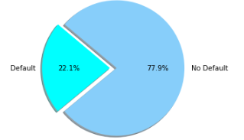
Dataset Overview
UCI Machine Learning Repository http://archive.ics.uci.edu/ml/datasets/default+of+credit+card+clients
Observations : 30,000
Attributes : 24
Customer Data
Default
Customer Data
No-Default
No-Default
No-Default

Slide 5
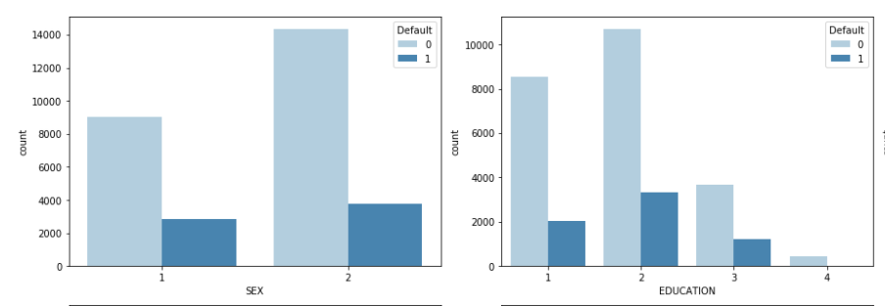
Data Exploration
Gender:
1 = Male
2 = Female
Female tend to default more than male.
Education:
1 = Graduate School
2 = University
3 = High School
4 = Others
University students default more than others.

Slide 6
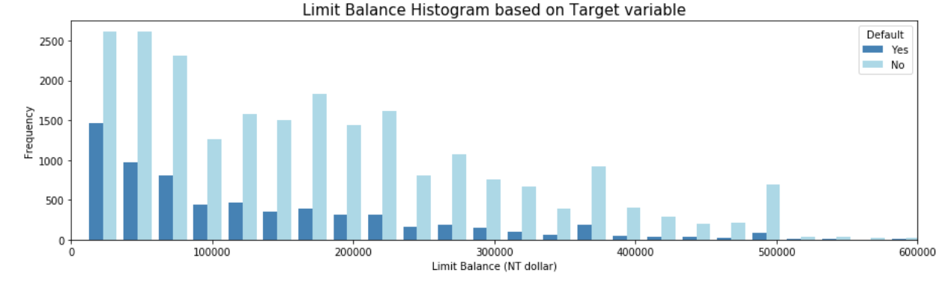
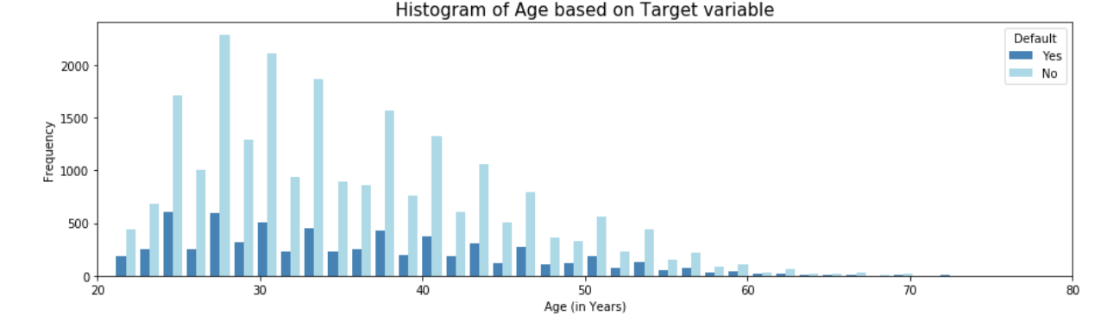
Data Exploration Continued…
Lower credit limit customers default more.
Customers of age group 20~35 tend to default more.

Slide 7
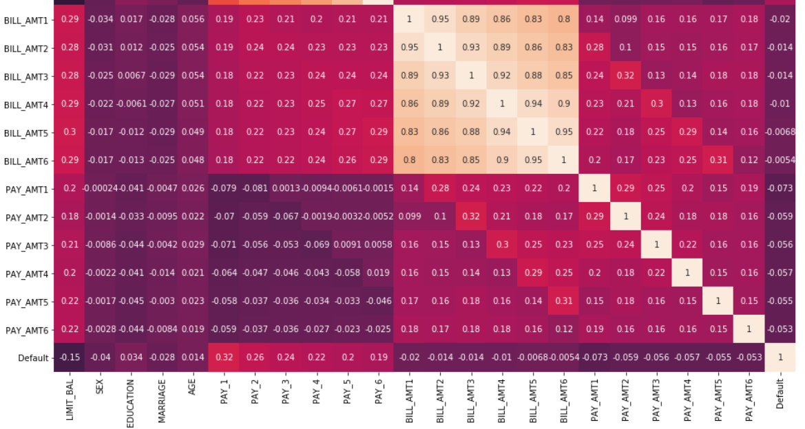
Correlation
September month’s payment status is highly positively correlated (0.32) with default.
Limit Balance is highly negatively correlated (-0.15) with default.
Bill amounts and payment amounts are moderately positively correlated with balance limit.

Slide 8
Pre-processing & Feature Engineering
DATA Pre-Processing
Feature Engineering
No null or missing values found.
Customer ID column dropped as not needed for analysis.
Marital Status 0 converted to value 3 (‘Others’).
Education Level (5 & 6 – ‘Unknown’) also converted to value 4 (‘Others’).
Target column (‘default.payment.next.month’) changed to ‘Default’ for better readability.
Recursive Feature Elimination
is used to select 10 most
relevant features
LIMIT_BAL
AGE
PAY_1
BILL_AMT1
BILL_AMT2
BILL_AMT3
BILL_AMT4
BILL_AMT5
BILL_AMT6
PAY_AMT1

Slide 9
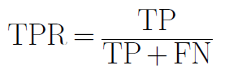

Model Evaluation
Models
Logistic Regression
SVM
Naïve Bayesian
kNN
Random Forest
Training set | 80%
Testing set | 20%
Hyper-parameters Tuning | GridSearchCV
Evaluation Metrics | Recall, Precision, ROC-AUC curve
Recall
Precision

Slide 10
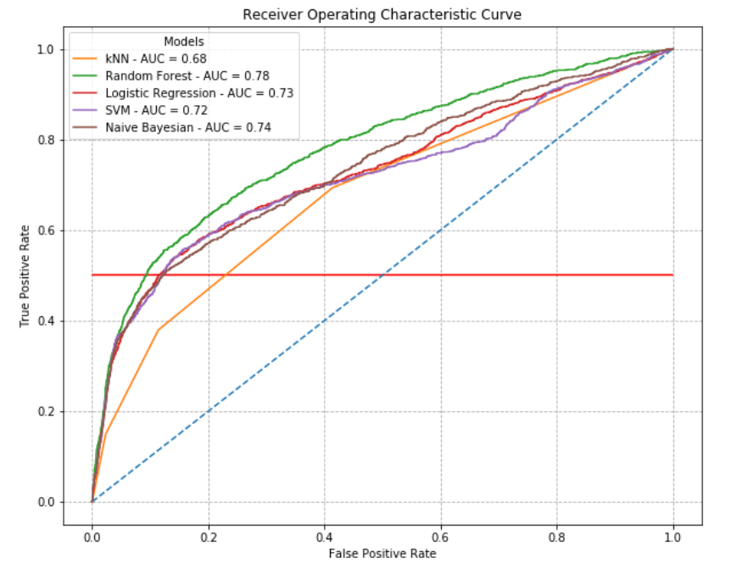
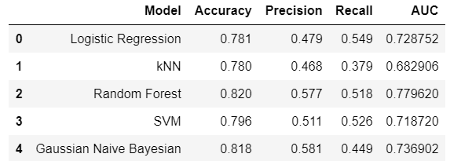
Results

Slide 11
Conclusion
Accuracies yielded from the model are no better than simply predicting all the clients as non-defaulters.
As I wanted a model that provides a balance between Recall & Precision as I do not want high recall with low precision (high False Positive values), ROC-AUC metric was evaluated.
Random Forest got the best performance based on AUC.
kNN seems not to be a good model for my data.
Feature selection is an important step in data science as it helps reducing training times by keeping only the most relevant and most-redundant features.

Slide 12
Thank You !!!

